Slide 1


Behind The Success Of Movies
Amit Finkman, Yonatan Adler, Amit Baras

Slide 2

01
02
03
04
Section A
Section B
Introduction
prior works and our innovation
Section C
Section D
Overview
Results and Conclusion

Slide 3
Introduction
Movie success insights
How can we tell the success of a movie before it is released in cinema?
What are the factors that impact the most?
Is their any factors combination that grantee movie success in all 3 parameters?
Our main goal in this project is to find out what are the most significant factors and connections that influence our success indicators and explained the rusults in scientific and research way based on studies done on similar topics
We measure success in three ways: gross, rating, and award winning

Slide 4

We know that we are neither the first nor the second to study the subject (to say the least) – the most is trying to build a regression model to predict the movie's rating, so we chose a path whose focus is the reasons and explains for the differences between the various factors for success and the focus is really not building a prediction model that only serves to help establish significant variables, but find the connections and give research explanations as to why they happen
familiarity with prior works and our innovation

Slide 5
Data Overview
The data for the project included two datasets that was taken from Kaggle and one dataset contains movie's released month that scrapped from IMDB site.
We cleaned our data from unnecessary features, Na's and anomalies. we left with 23 variables And 3885 movies.
We divided the variables for 3 groups:
Important features: Director, Actor, Genres, Release month, Facebook likes, gross and imdb score.
Calculated important features: ROI, Oscar winner(binary), succeed Director and Actor rating/gross history.
Less important features/ useless: Title, content rating, Aspect Ratio, Color Company, Duration, Language, Filming Location, number of critic reviews, number of voted users.

Slide 6
Results and Conclusion
We have found serval surprising insights but interesting in them are:
1. The movie month impact on the movie goals -
Everyone knows that most of the profitable/block basters movies go out in the summer months because of the summer vacation and the load of visitors, so why are there so many movies coming out actually in the winter seasons.
As we can see in chart D, December through February are the key months for distributors looking to market their films for the upcoming award season. The reason these two-three months are the best for awards contenders is simple... it's just a couple months before ballots, Oscar and more awards go out, when the films are fresh in the public's and especially the voters' minds. It's the 'kiss of death' to release a hopeful awards contender in March or April. People won't remember them.
להוסיף משהו על דדפול

Slide 7
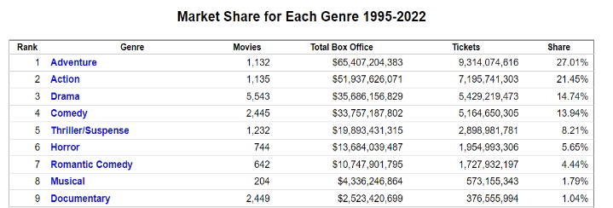
Results and Conclusion
E
We have found serval surprising insights but interesting in them are:
.
we can spot that Action & Adventure films have taken the top spot at the box office, chart E shows that about half of the summer movies are Action & Adventure. So why there are still other genres taking part in the film industry?
fun fact: For every Action film made in North America since 1995, five Drama films were made. As far as genre goes, Drama and Comedy make up the majority of the production pie (chart F), but here's the rub , Action & Adventure make up most of the profit pie.
The reason is return on investment.
That is a financial ratio used to calculate the benefit an investor will receive in relation to their investment cost. In chart G we can see clearly that even though Action & Adventure have higher profit than all other genres, the ROI is far from best, and that is why production companies still making other genres more than Action & Adventure.
Table from: https://www.the-numbers.com/market/genres

Slide 8
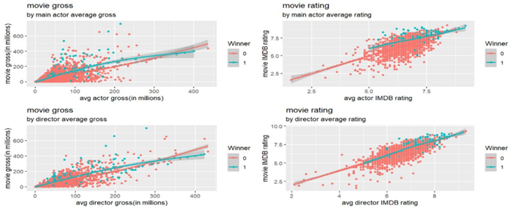
Results and Conclusion
E
We have found serval surprising insights but interesting in them are:
We read a article about how much influence there is to the Director and Main actor of movie on his imdb rating about we didn’t find connection so we added a new parameters that calculate avg director/ actor avg rating until his correct movie and found that….

Slide 9
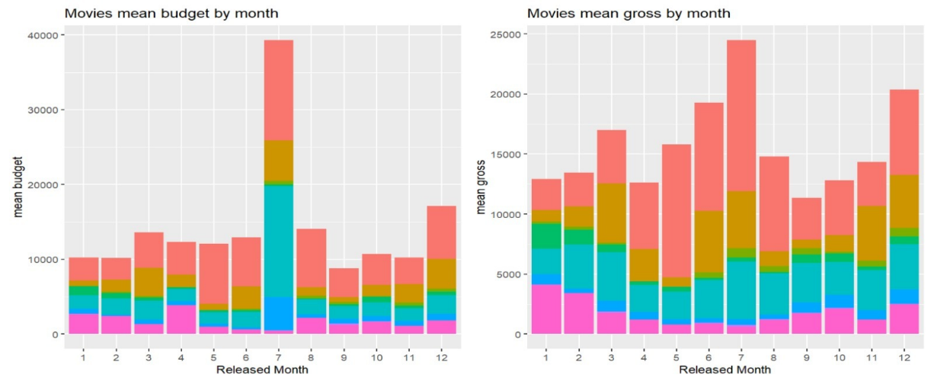
Charts
A
B

Slide 10
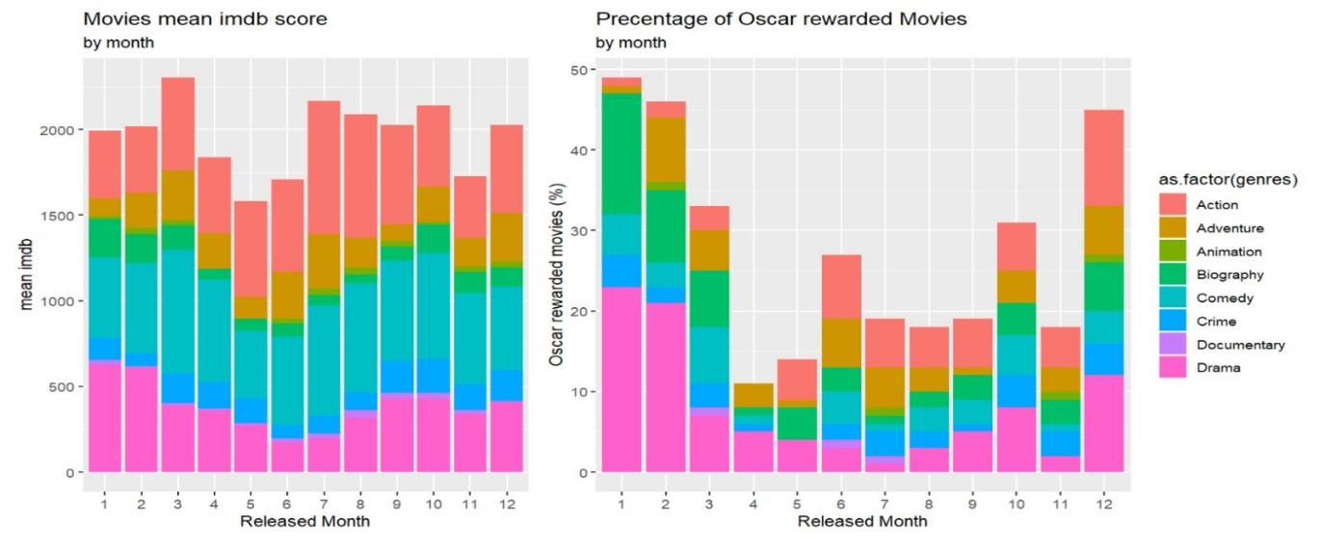
Charts
C
D

Slide 11

בהצלחה בתקופה מבחנים

